Slide 1
NBA Game prediction
By: Kshitij Agarwal
Notes:
Hi. My is Kshitij Agarwal. I choose to do my final project on predicting the final outcome of NBA Games

Slide 2
Problem
Predict the final outcome for a game
We have all the stats until the end of the 3rd quarter
Notes:
The problem that I am trying to solve is predicting the winner of a game based off of the stats by the end of the 3rd quarter. These stats includes the score, assists, blocks, steals, rebounds.

Slide 3
Data
Play-by-play dataset
Start of 2016 season to now
Over 2 million plays
Game Type, Winning Team, Quarter, Away Team, Away Score, Home Team, Home Play, Home Score, Shot Type, Shot Outcome, Assister, Blocker, Foul Type, Rebound Type, Free Throw Outcome, Turnover Cause
Notes:
I was able to find a play by play dataset on Kaggle. This covered every single game from the start of the 2016-2017 season all the way until today. This resulted in well over 2 million plays. Each play had roughly 50 attributes. Depending on the play, the corresponding stat would have the correct data. For example, if a player made shot, shot type and outcome would be filled, but turnover would remain empty. All of the stats that I used are written on the slide.

Slide 4
Procedure
Import Data
Go line by line and record quarters 1, 2, and 3
Check stats I want to track
Keep a count for each stat
Feed different sets of data into Libraries
Notes:
To solve this problem, I downloaded the data, and I loaded it in my environment. I went line by line through each of the 2 mil lines and checked if the quarter was either 1, 2, or 3. If it was, I would check if there was any data that I could use. If I found something to track, I had a counter ready to either increment of decrement based on which team made the play. Going through all of the data, I was able to take out all the relevant information and feed it into libraries for testing.

Slide 5
Libraries
TruncatedSVD
LogisticRegression
KNeighborsClassifier
DecisionTreeClassifier
RandomForestClassifier
KMeans
Notes:
These are the main 6 libraries that I used to improve my data and make predictions. TruncatedSVD is a demenionality reduction based library. It is designed to cut down the attributes across my matrix to make the data more relevant and less sparse. I used this library to cut down from 15 features to just 4. Logistic and knn are tests that compare one point to every other point. They then use their respective algorithm to use that and make prediction for new data points. Tree and forest is a learning model that produces a set of rules. It takes each test data, feeds it into the rules to get produce a label. Both of these metrics did not use the data that was reduced from truncatedSVD as it gave them less rules to make and actually significantly hurt the accuracy. Kmeans is clustering. It graphs every point and tries to find a centeroid for each of the different groups that form in the data. Which ever centeroid is closest to a data point will be labeled as such. Apart from these libraries, I also used test_train_split to divide up testing data from training data and classification_report to analyze the accuracy of the clustering data. The only library I did not use from sklearn was pandas. This allowed to me quickly remove bits of data from my matrix

Slide 6
Results
Test using all of the collected data
Test using just the score difference
Test using all but the score difference
Notes:
Prior to running different tests, I predicted that the score of the game would have a huge impact on who won. I know that it is not that bold, but also predicted that without the score, the rest of the stats would be able to show the stronger team, and therefore would still be pretty accurate at predicting the winner. To test this, I used all the data available to me, and tried to make it as accurate as possible. That set it as the benchmark so that we can compare the rest of the data. Then I could change the data sets, and retest.

Slide 7
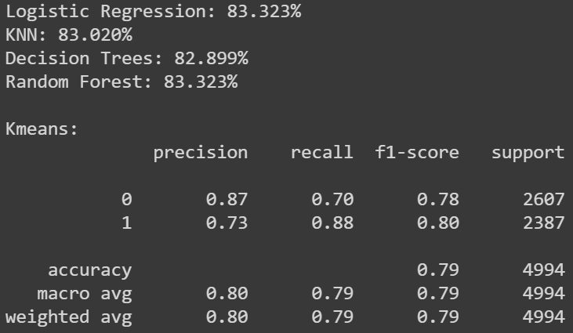
Best results
Notes:
This is the best result that I was able to achieve using all of the data that I collected.
0 indicates that the home team lost, and the 1 indicate that they won. Analyzing the data, we can see the algorithm predicted that the home team won a lot more often than they really did. Overall, even through clustering, it had roughly an 80% success rate based on F1 scores.

Slide 8
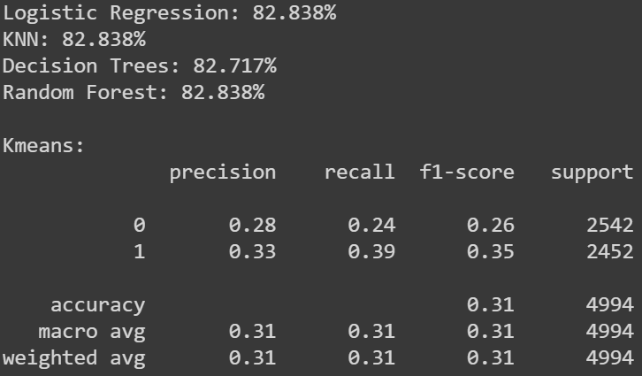
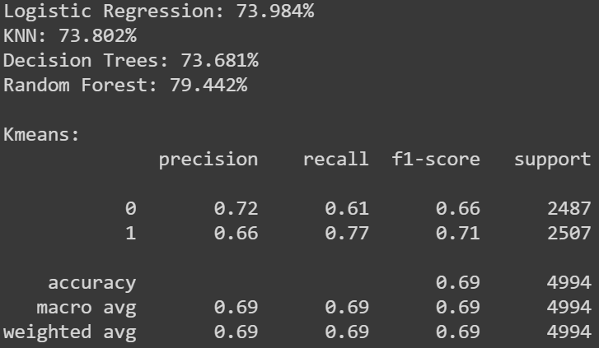
Game score impact
Using only Game Score
Using all other Data
Notes:
These are the results from using different data sets. I still used every single play, but I changed which features I kept. On the left is the data from just keeping the score of the game at the end of the third period. And on the right, I dropped the score and used all of the other stats to make my predictions. The difference in accuracy is very very small using just the scores. It dropped roughly 0.5% across the board. This was a lot smaller of a margin that what I thought I would have gotten. Clustering however, was significantly inaccurate. And this makes sense as there is only one dimension to work with. More interesting is the predictions without the score. While this accuracy dropped roughly 9% in most the categories, it shows that the rest of the stats still have the ability to show the stronger team. The accuracy for RandomForest only dropped about 4%. And clustering with multiple dimensions proved to significantly improve the accuracy from the left.

Slide 9
Applications
Sport Betting
Game Analysis
Notes:
The main advantage of using data like this is useful in sport betting. Watching a game, you usually see who the better team from the very beginning. However, translating official statistics to predicting the winner of a game is still a challenge. And more importantly, there is always a chance to see if the underdog can pull an upset. Getting the chance of winning into a percentage is very important for companies that make wagers. However, this also can be used to show how well a team is performing even they the scoreboard isn’t in their favor. The third test I ran showed that without the score, I was able to accurately predict who would win a game around 74% of the time. This could show that a team with better stats might still have a chance to win the game.

